Slide 1
Iterators, Generators, Decorators and Applications
Gokkul Nath T S (EGOKKUL)

Slide 2
agenda
Iterators
Generator
Comprehensions: List , Dictionary and Generator Expressions
Decorator
Zip, Map, Filter and Reduce
Itertools Module: (Docs with Code Walkthrough )
Methods on Infinite iterators
Methods on finite iterators
Combinatoric iterators
Functools Module:
Partial
Partialmethods
Reduce
Wraps

Slide 3
Understanding Programming Styles
Imperative style of programming: statements are executed to mutate the state. Procedural programming is a subset of imperative that relies on using procedures to evaluate these state changing computations. State for the program is stored in local or global data structures and is manipulated by invoking functions. (Same as C language)
In object oriented programming, objects are the main methods of computation. In addition these objects hold program state, and allow mutation of that state through invocation of their methods. (Java and C++)
declarative style of programming, the code describes the what rather than the how. SQL, for example, is declarative because it describe the relational algebra for the result of a query. They describe the result rather the mechanics of calculating it
Functional programming is a subset of declarative programming that achieves the logic of the program by invoking functions. Usually, in strict functional languages, side effects are kept to a minimum or eliminated. Calling a function with the same input should be idempotent and always return the same value

Slide 4
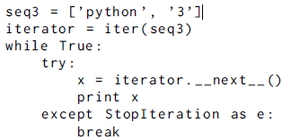
The Iterator Protocol
Python has a built-in protocol that defines the process for iteration over items in a container utilizing the methods __iter__ and next (in Python2 ) or __next__ (in Python 3)
Technically, in Python, an iterator is an object which implements the iterator protocol, which consist of the methods __iter__() and __next__().
iteration pseudocode is actually implemented in cPython by generating byte code when a for loop is encountered. (Memory Efficient and Fast)

Slide 5
Iteration in Python
Sequence-like objects are iterable in Python.
User defined classes may also be iterable by implementing the __iter__ special method.
Iterating over dictionaries loops over the keys in an arbitrary order while Iterating over a string loops over the characters.
An iterator is an object that contains a countable number of values.
An iterator is an object that can be iterated upon, meaning that you can traverse through all the values.

Slide 6
Iterator vs Iterable
An object that allows iteration is called an iterable. This object is required to have an __iter__ method that returns an iterator, which could be the same object but is usually a new object.
Note : iterators are stateful and only able to traverse the sequence once—the iterator is then said to be exhausted.
Lists, tuples, dictionaries, and sets are all iterable objects. They are iterable containers which you can get an iterator from.
All these objects have a iter() method which is used to get an iterator
Iterators only iterate once, while iterables can be used to do so repeatedly.

Slide 7
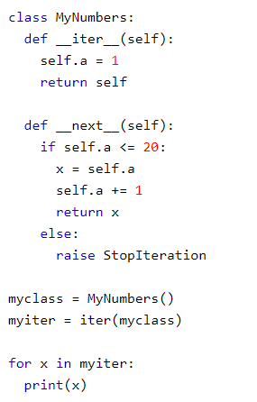
Create an Iterator
To create an object/class as an iterator you have to implement the methods __iter__() and __next__() to your object.
We Know that all classes have a function called __init__(), which allows you do some initializing when the object is being created.
The __iter__() method acts similar, you can do operations (initializing etc.), but must always return the iterator object itself.
The __next__() method also allows you to do operations, and must return the next item in the sequence.
Creating an iterable:
If next method is not implemented then the object is an iterable and can be used externally/manually to create an iterator

Slide 8
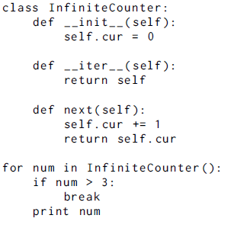
Iterators can be infinite
There is potential for running out of memory if a large list needs to be created. An iterator, generating results as it goes, might incur a bit of overhead due to repeated next function calls, but will not gobble memory.
Eg. An iterator can create an infinite series, which is impossible for a list producing function

Slide 9
Generators
Limitations with Iterator:
There is a lot of overhead in building an iterator in Python; we have to implement a class with __iter__() and __next__() method, keep track of internal states, raise StopIteration when there was no values to be returned etc.
Python generators are a simple way of creating iterators. All the overhead we mentioned above are automatically handled by generators in Python.
Simply put a generator is a function that returns an object (iterator) which we can iterate over (one value at a time).
Generators are not executed when they are invoked, only when they are iterated over. Generators freeze their state after a yield statement.
Generators can be iterated over. Because the result of the generator is an iterator, it follows the iterator protocol and can be iterated over.
Creating Generators:
Defining a normal function with yield statement instead of a return statement.
If a function contains at least one yield statement (it may contain other yield or return statements), it becomes a generator function. Both yield and return will return some value from a function.
Note : A return statement in a generator will cause the loop to exit.

Slide 10
Generator vs Normal function
Generator function contains one or more yield statement.
When called, it returns an object (iterator) but does not start execution immediately.
Methods like __iter__() and __next__() are implemented automatically. So we can iterate through the items using next().
Once the function yields, the function is paused and the control is transferred to the caller.
Local variables and their states are remembered between successive calls.
Finally, when the function terminates, StopIteration is raised automatically on further calls.
Note: Generator object can be iterated only once. we can use generators with loops directly.

Slide 11
Why generators are used in Python?
Easy to Implement:
Generators can be implemented in a clear and concise way as compared to their iterator class counterpart.
Memory Efficient:
A normal function to return a sequence will create the entire sequence in memory before returning the result. This is an overkill if the number of items in the sequence is very large. While generator implementation only produces one item at a time
Represent Infinite Stream:
Excellent medium to represent an infinite stream of data.
Pipelining Generators

Slide 12
Comprehensions
Comprehension:
Comprehension is an elegant and concise way to create new container item from an existing container item in Python.
Types:
List Comprehension
eg: pow2 = [2 ** x for x in range(10)]
Dictionary Comprehension
eg: inv_dict = { v,k for k,v in dict.items()}
Generator expression :
eg: # Intialize the list
my_list = [1, 3, 6, 10]
a = (x**2 for x in my_list)
sum(x**2 for x in my_list)

Slide 13
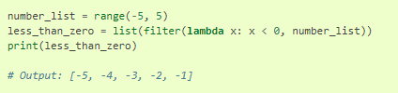
Map, Filter and Reduce
Map:
Map applies a function to all the items in an input_list.
Syntax: map(function_to_apply, list_of_inputs)
Most of the times we use lambdas with map so I did the same. Instead of a list of inputs we can even have a list of functions! (See Jupyter for Examples)
Filter:
Filter creates a list of elements for which a function returns true.

Slide 14
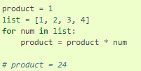

Reduce:
Reduce is a really useful function for performing some computation on a list and returning the result. It applies a rolling computation to sequential pairs of values in a list.
Normal Way :
Using Reduce Method

Slide 15
Function – Misc. Concepts
Function instances: After a function is defined, the function name then refers to a function instance.
Functions are callable. Because they are callable, they can be invoked.
In python 2 use : callable(object) to check if the object is callable
In Python 3 use : hasattr (object , ’__call__ ’) or isinstance (object , collections . Callable )
The invocation construct in Python is to add parentheses around any arguments to a callable object.
if a class implements the __call__ method, you can invoke instances of the class

Slide 16
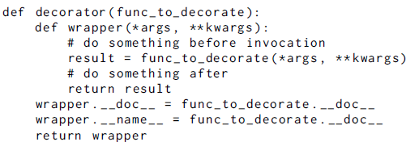
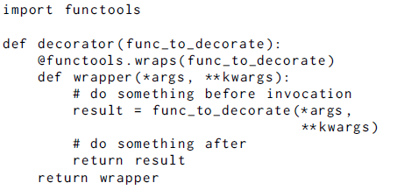
Decorators
They are functions which modify the functionality of other functions. They help to make our code shorter and more Pythonic.
Decorators let you execute code before and after a function.

Slide 17
Parameterized decorators
Often a decorator needs to be customized on a per function basis.
Example: A REST API might use require_http_methods decorator decorates a view and ensures that it uses the correct http methods — GET, HEAD, POST, PUT, etc — or a combination of those methods.
method to generate a parameterizable decorator is to wrap the decorator with another function.
The parameterized decorator itself is actually a decorator generator
Note: The syntactic sugar for decorating with parameterized decorators is to declare the decorator before the function definition

Slide 18
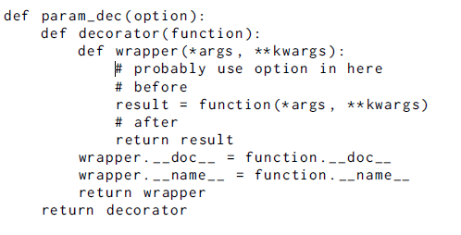
Parameterized template

Slide 19
Common uses for decorators
Decorators can alter or inspect:
function arguments
function being wrapped
results of the function
Whenever we need to modify/change the function depending on state of variables we can use decorators.
Timing out a function call
Access control
Logging the amount of time spent in a function
Retrying a function that might fail

Slide 20
itertools—Iterator Functions
Purpose The itertools module includes a set of functions for working with sequence data sets.
The functions provided by itertools are inspired by similar features of functional programming languages such as Clojure and Haskell.
Iterator-based code offers better memory consumption characteristics than code that uses lists. data is not produced from the iterator until it is needed, all data does not need to be stored in memory at the same time.

Slide 21
functools—Tools for Manipulating Functions
The functools module provides tools for adapting or extending functions and other callable objects, without completely rewriting them.
The function wraps (which is a decorator itself) found in the functools module, will update __doc__ and __name__ as well.
Partial and Partialmethod: See Notebook for Example and usecases

